Slide 1
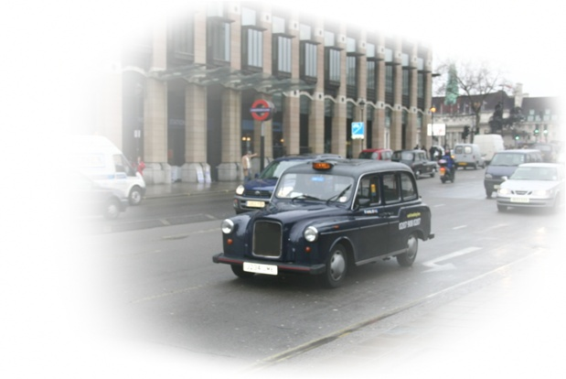

E-Road Management System
The Research …

Slide 2
Why Our (E-Road Management) System?...
    Policing of road traffic in Sri Lanka has become a major task for police.
    But this is a difficult task to manually control it.
    Our team create an application to solve this problem.

Slide 3
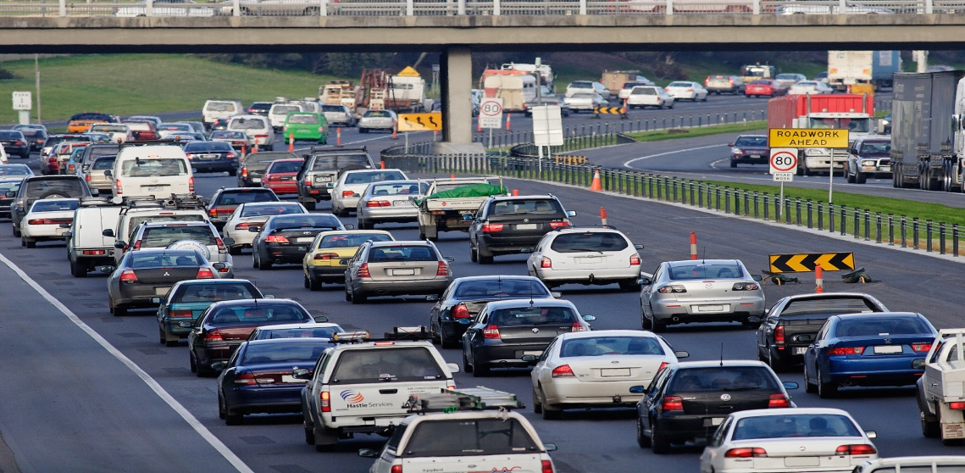
Causes Of Traffic…
Most Important reason is that the increase of population, too much of vehicles cause traffic and it interrupt the people.
Accidents occur.
Increasing no of vehicles
Growth of country income
Poor road development
Increase of no of road users

Slide 4
Solutions
E-Path Identifier
E-Statistical Analyzer
E-Mobile Tracker
E-Destination Services

Slide 5
E-Path Identifier
This is the module the attention is mainly focus on the reducing the traffic by indicating to the system as soon as it’s possible, to meet all requirements
our system provide services to Client.
Optimization of traffic flow by synchronization between neighboring traffic signals.
Ensuring faster passage for emergency vehicles like
ambulances, fire engines etc.

Slide 6
E-Statistical Analyzer
The best idea to plan the future is get to know the past. and this is the module carries out the research in past motor ways.
    The best way to plan the future by analyzing the past data.
    Having full of graphs generation and the Simulator to predict the future .

Slide 7
E-Mobile Tracker
This technology comes through as the optimal portable solution.
In SriLanka, since there is no mobile phone transport services like EMT system.
Voice guiding is the best outcome of our project.
In this system most of the cab services are implemented.

Slide 8
E-Destination Services
    This module helps to improve efficient transport
    services and destination management services.
    Transport services plays a huge role in a growth of a Country and tourism provides is the major income in our Country. To get gain more income, ERMS provided with a web base system.

Slide 9
Thank You !...

